Slide 1



Warung Kita App
E-Commerce
“We’re here to serve only the best products for you”
Sprint 2 Review
By : Pentagon Team
Notes:
Source
https://gumroad.com/l/macbook-pro-mockups?source=post_page---------------------------
https://www.freepik.com/free-vector/nothern-lights-background_4666677.htm
https://dribbble.com/shots/3848433-iPhone-X-Flat-Mockup-Free
https://unsplash.com/photos/mpN7xjKQ_Ns

Slide 2
Our Team
Tech Lead
Bayu Indra
{Pentagon}
Lead Assist
BE Programmer
BE Programmer
BE Programmer
M. Rasyid
Rendra P.
Yohanes C.
Anik J.

Slide 3
Sprint 2 Planning
Complete Unfinish Sprint 1
Fungsi Total Dalam Keranjang
User Open Shop
Dokumentasi
Otomatis Update Stok Product Jika Ada Order
To Do List On Sprint 2
Subtotal Function In Order Product
Testing End Point
Soft Delete User
Token Verification For Login User
Upload File Foto Product And Jasper Report
User Open Shop
Deploy To Heroku
Front End (HTML)
Optimize Response DTO
Clean Code
Documentation

Slide 4
Done & Unfinished
Sprint 2 Status
Subtotal Function In Order Product ( Done )
Testing End Point ( Done )
Soft Delete User ( Done )
Token Verification For Login User ( Done )
Upload File Foto Product And Jasper Report ( Done )
User Open Shop ( Done )
Deploy To Heroku ( Done )
Front End (HTML) ( Done )
Optimize Response DTO ( Done )
Clean Code ( Done )
Documentation ( On Process )

Slide 5

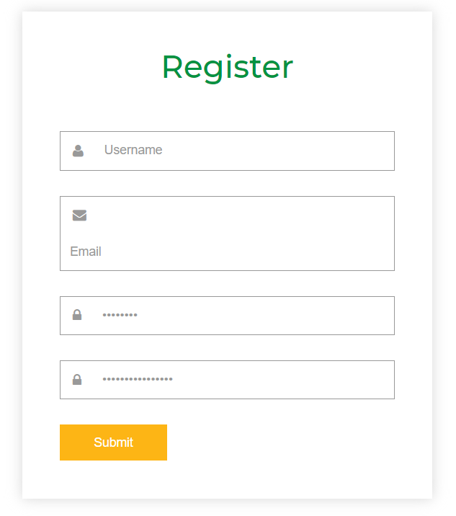
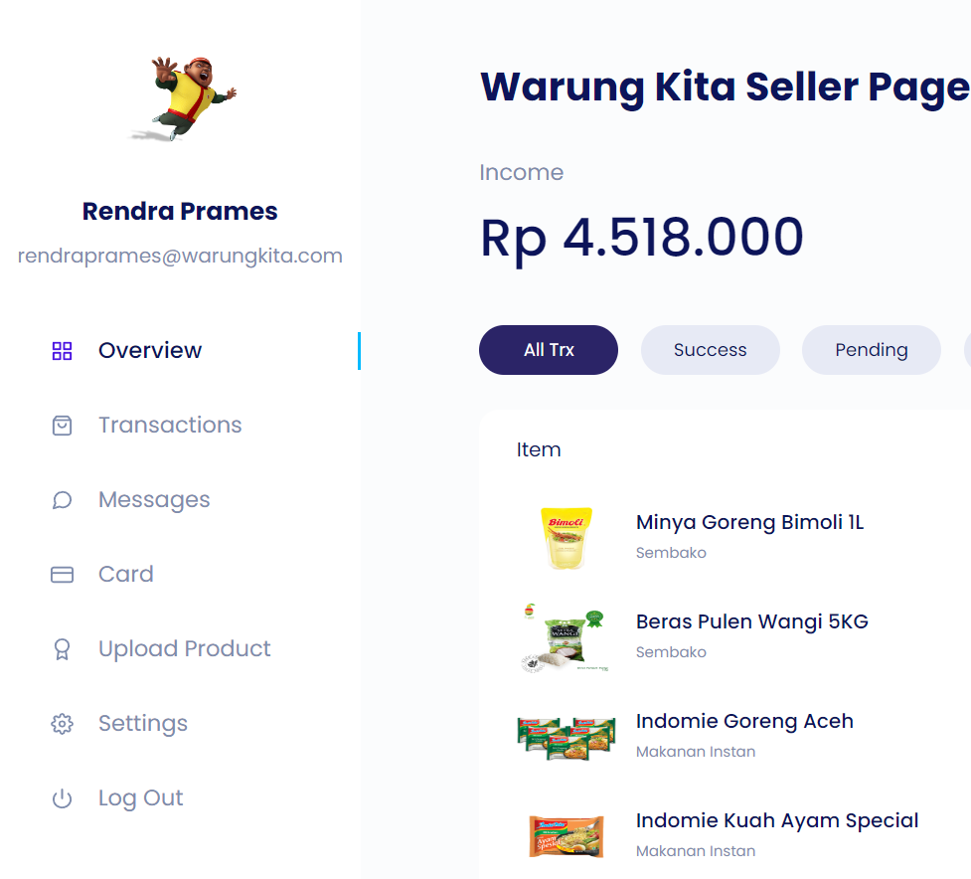
Warung Kita HTML View
Home Page
Seller Page
Register Page
User can upload their product and sell to market
Our main page, showing what product in our market that user can buy
Register page for new user
01
03
02

Slide 6
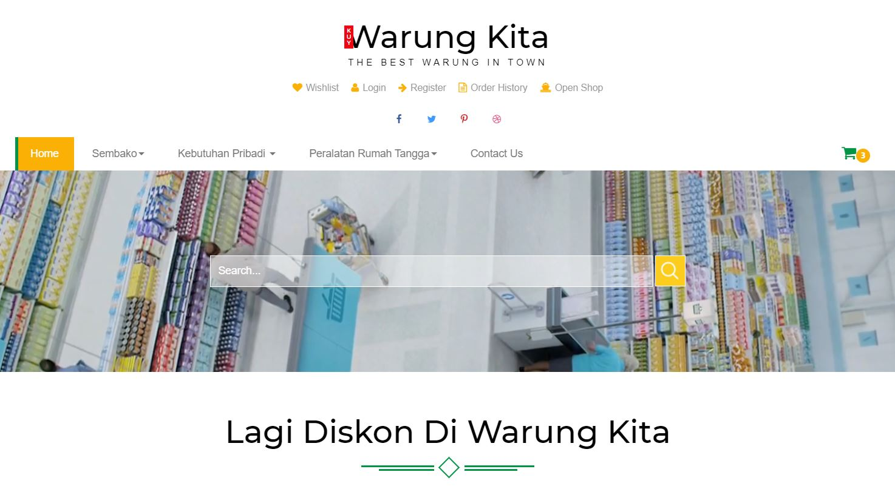
Home Page

Slide 7
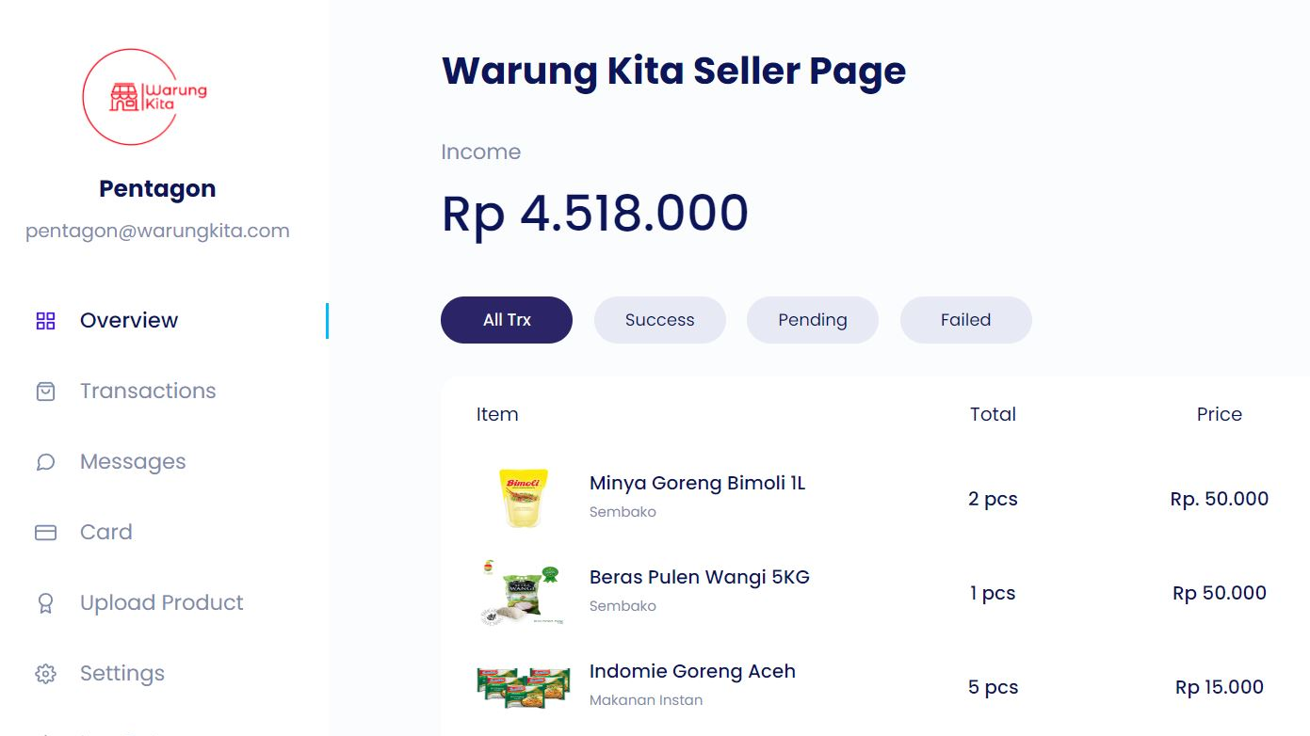
Seller Page

Slide 8








Tech. & Tools We Use To Build This App.

Slide 9

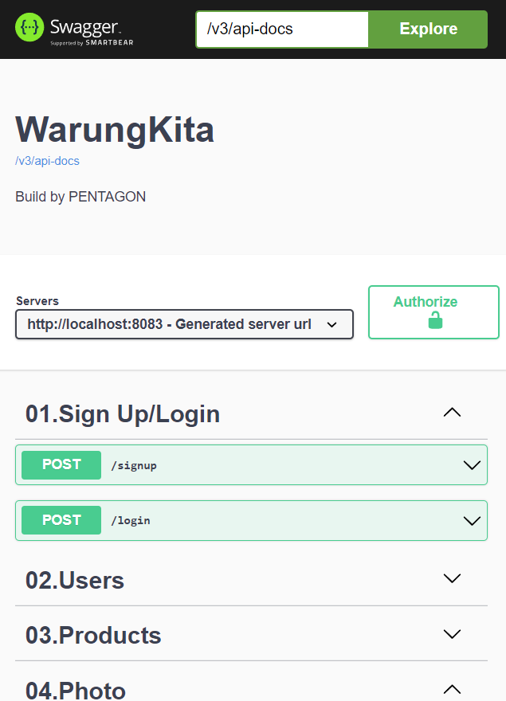
Demo API
RUN

Slide 10
Thankyou

